Slide 1




Name: Kshitij Shah
Business Function: IT Infra
Mentor: Siddeshwar Borkar / Dhananjay Patil
Buddy: Aditya Katkar
NextGen Internship Program FY 25-26

Slide 2

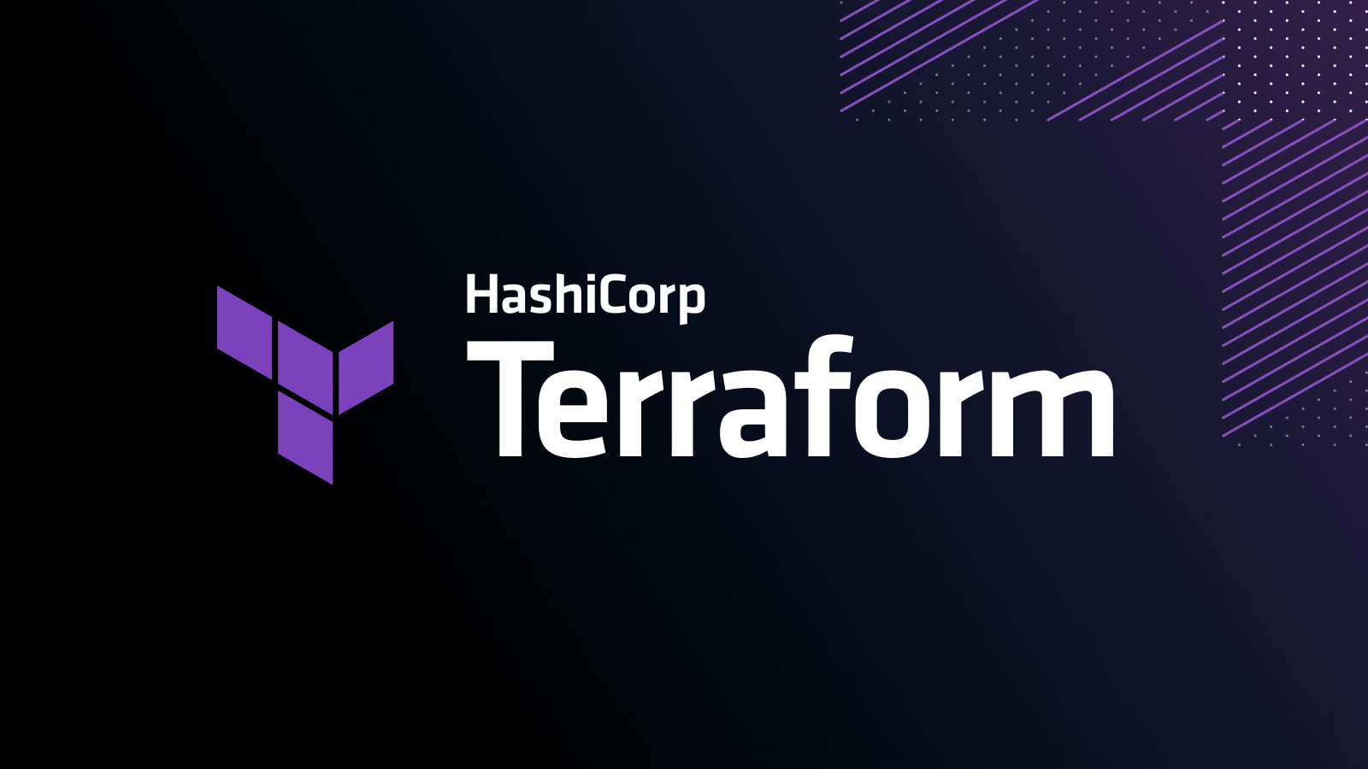
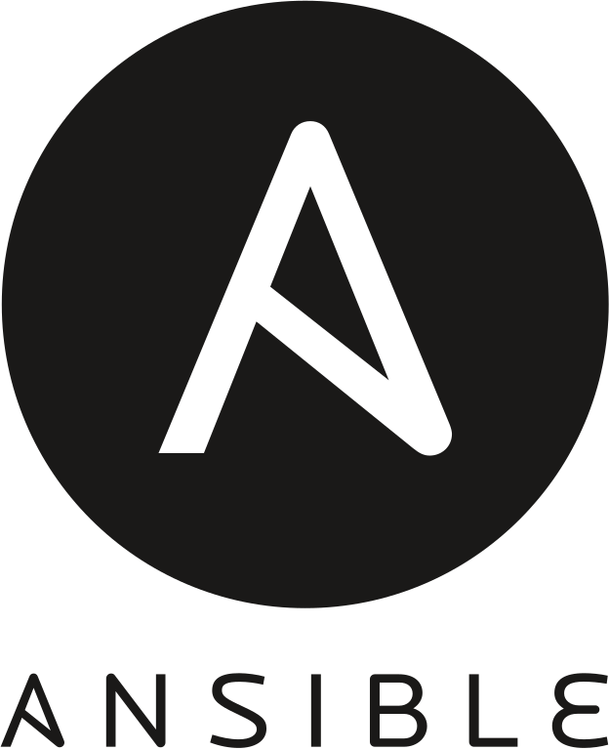
Objectives of Project
Objective 1: Embracing Modern Tools for Smarter Operations
Adopt modern infrastructure automation tools such as Terraform and Ansible to replace outdated manual systems and streamline IT operations.
Key Benefits: 1. Accelerated Deployment: Automate provisioning and configuration to speed up delivery cycles. 2. Improved Reliability: Minimize human error through consistent, repeatable processes. 3. Cost Efficiency: Reduce operational overhead and maintenance expenses. 4. Operational Agility: Scale and adapt infrastructure quickly to meet evolving business needs. 5. Future-Ready Architecture: Lower technical debt and build a more resilient, maintainable environment.

Slide 3
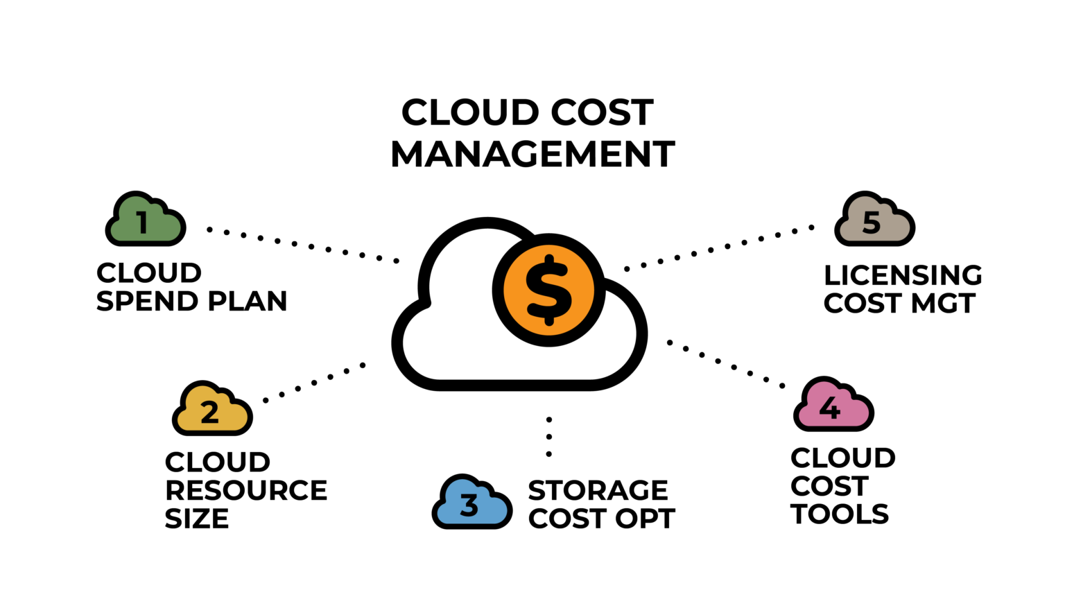
Objectives of Project
Objective 2: Cost Optimization Through Data-Driven Insights
Utilize advisory reports and analytics to identify cost-saving opportunities and enhance financial efficiency across operations.
Key Benefits: 1. Informed Decision-Making: Leverage data insights to guide strategic financial actions. 2. Expense Reduction: Identify and eliminate unnecessary or underutilized resources. 3. Improved ROI: Maximize the value of investments through targeted optimizations. 4. Continuous Optimization: Establish a feedback loop for ongoing cost control and performance improvement. 5. Strategic Planning: Support long-term financial planning with actionable intelligence.

Slide 4
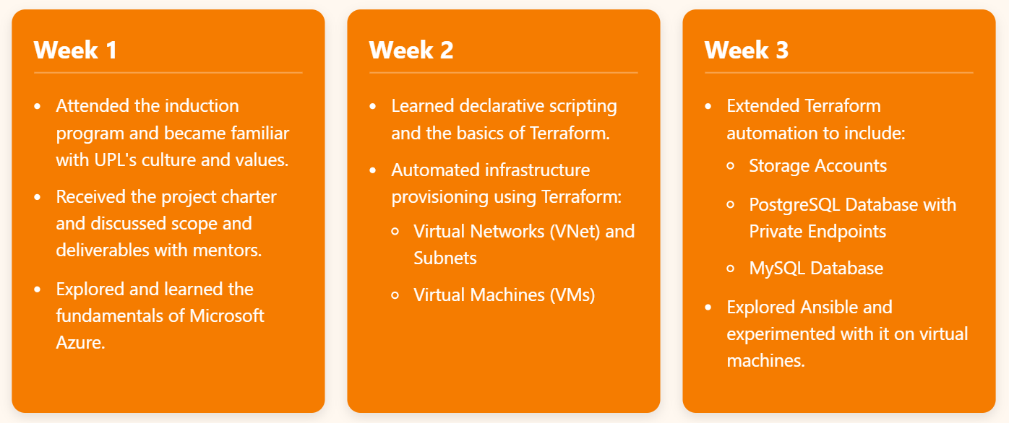
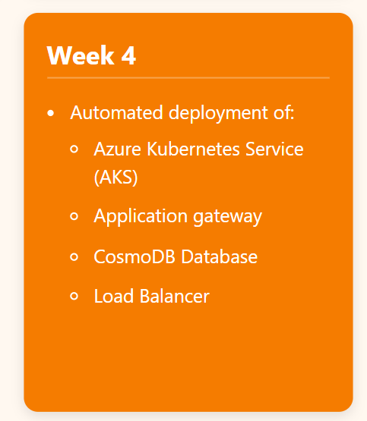
Scope and Deliverables

Slide 5
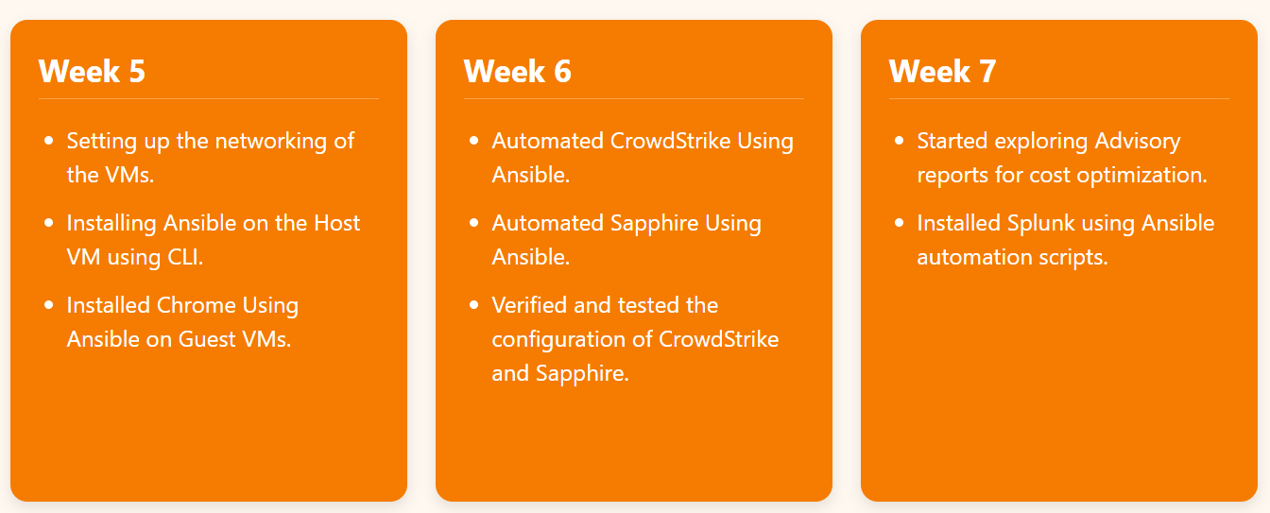
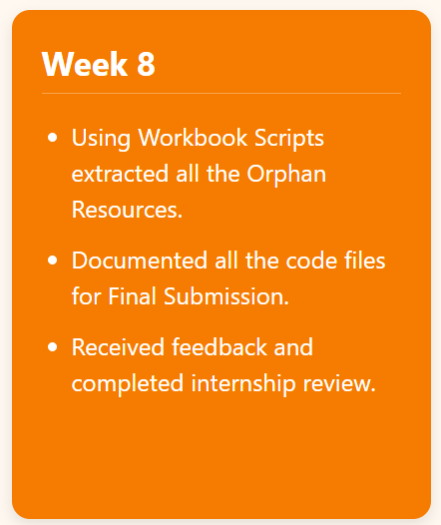
Scope and Deliverables

Slide 6
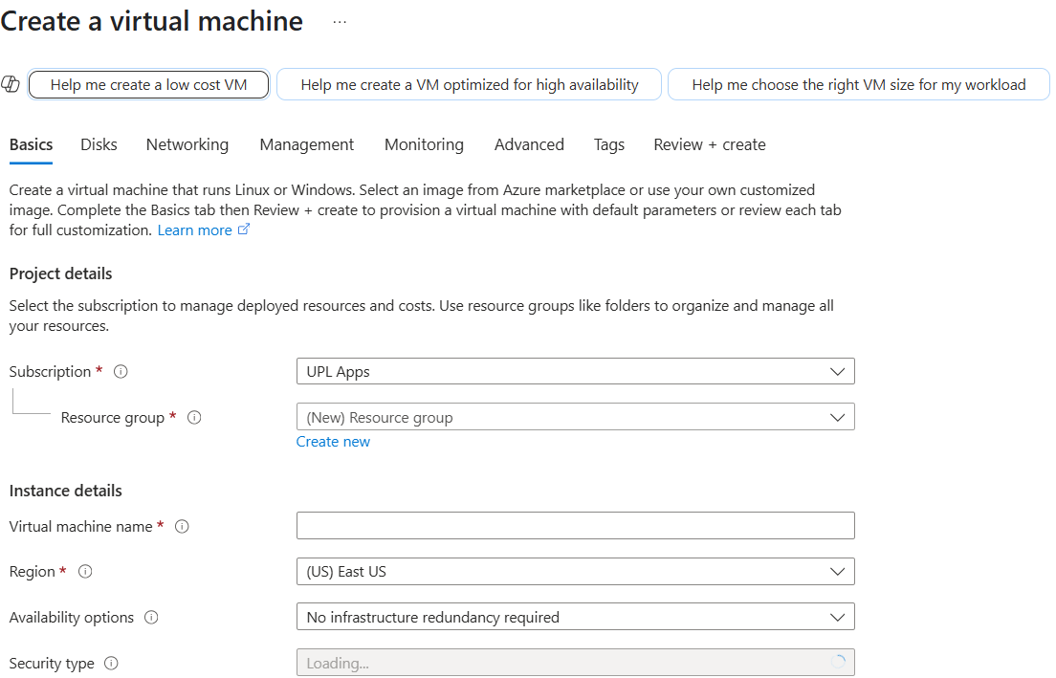
Creating resources on Cloud: Manual vs. Automated
Manual Creation:
Resources are created one-by-one using cloud portals (e.g., Azure Portal, AWS Console).
Involves clicking through UI forms and settings.
Time-consuming and prone to human error.

Slide 7
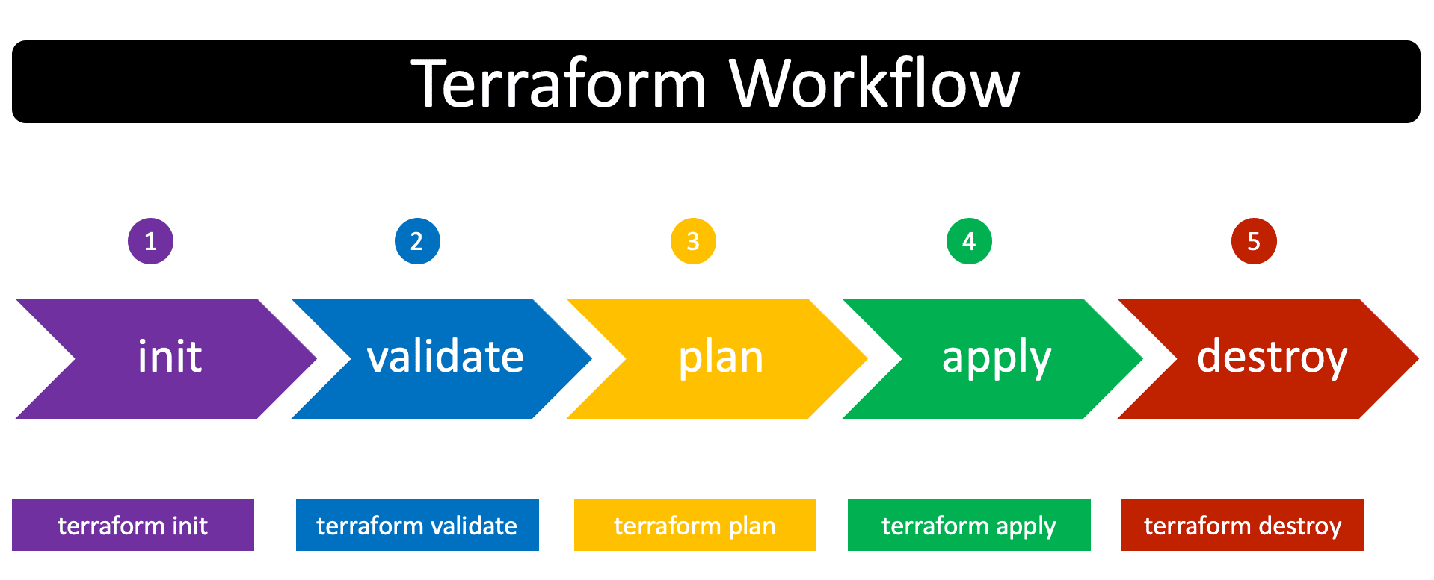
Automated Creation: Using Terraform
Easy to Use: Write simple code to create and manage cloud resources.
Consistent: Ensures the same setup every time—no manual errors.
Automated: Saves time by automating infrastructure deployment.
Cloud-Agnostic: Works with AWS, Azure, Google Cloud, and more.
Version Control: Track changes and roll back if needed.
Scalable: Easily manage small or large infrastructure setups.

Slide 8
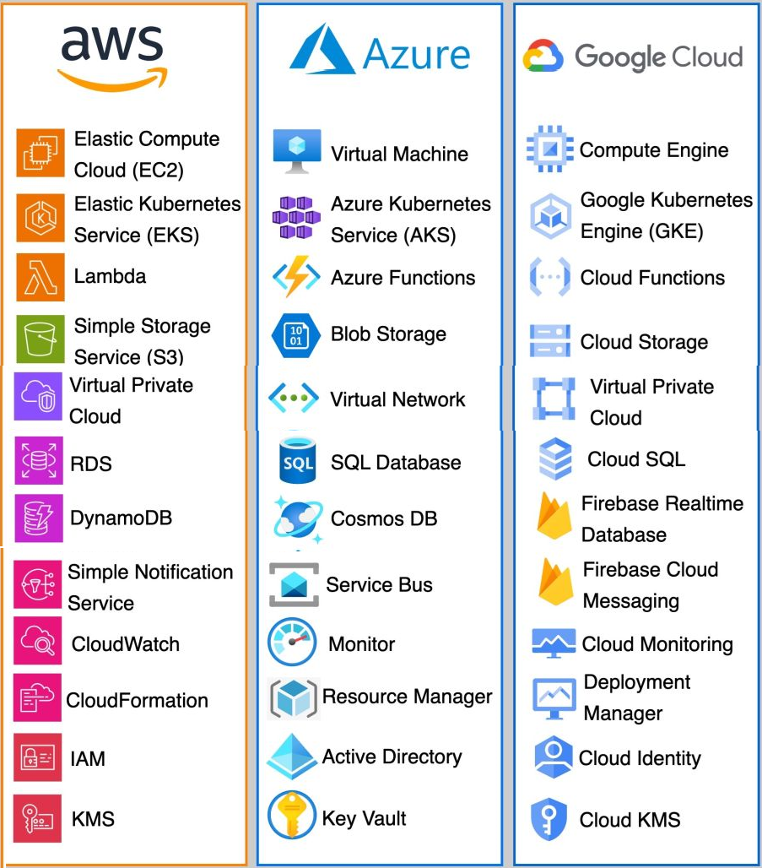
Resources Created using Terraform
Virtual Machines(VMs)
Virtual Network and Subnet
Storage Account
Postgre Database with private end-point
MySQL Database
Azure Kubernetes Services
CosmoDB Database
Application Gateway
Load Balancer

Slide 9
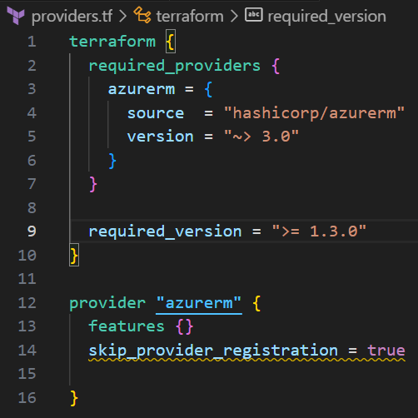
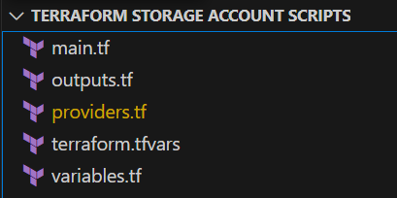
General Structure of Terraform Scripts
providers.tf Defines the cloud provider (e.g., Azure, AWS).
main.tf Describes the infrastructure to be created (e.g., VM, storage).
variables.tf Makes the script reusable and dynamic.
output.tf Displays useful information after deployment.
terraform.tfvars A special file used to store variable values separately from the main.tf These scripts run simultaneously to create a new resources.

Slide 10
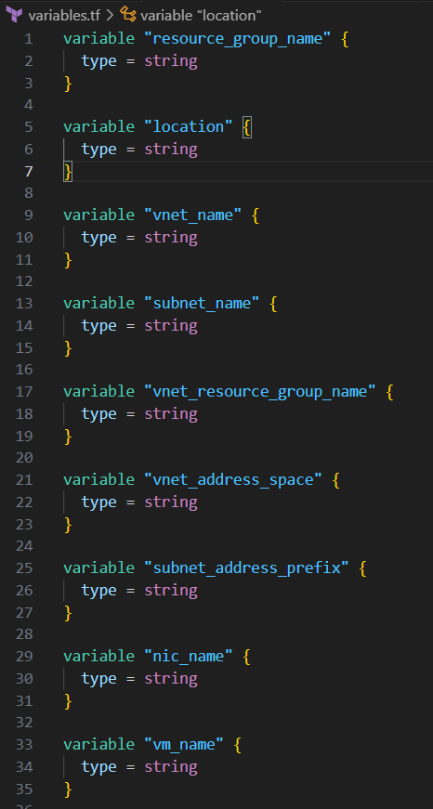
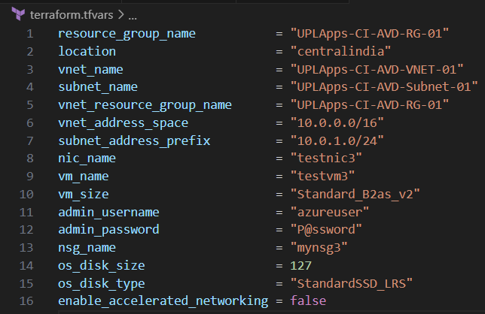
General Structure of Terraform Scripts
Variables.tf
Terraform.tfvars

Slide 11
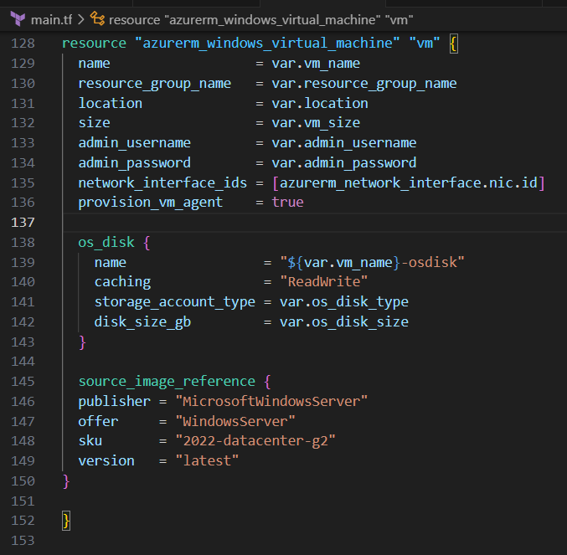
General Structure of Terraform Scripts
Main.tf

Slide 12
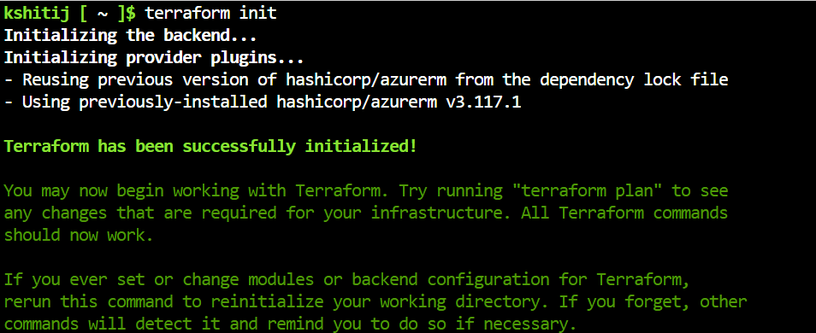
Virtual Machines(VMs)

Slide 13
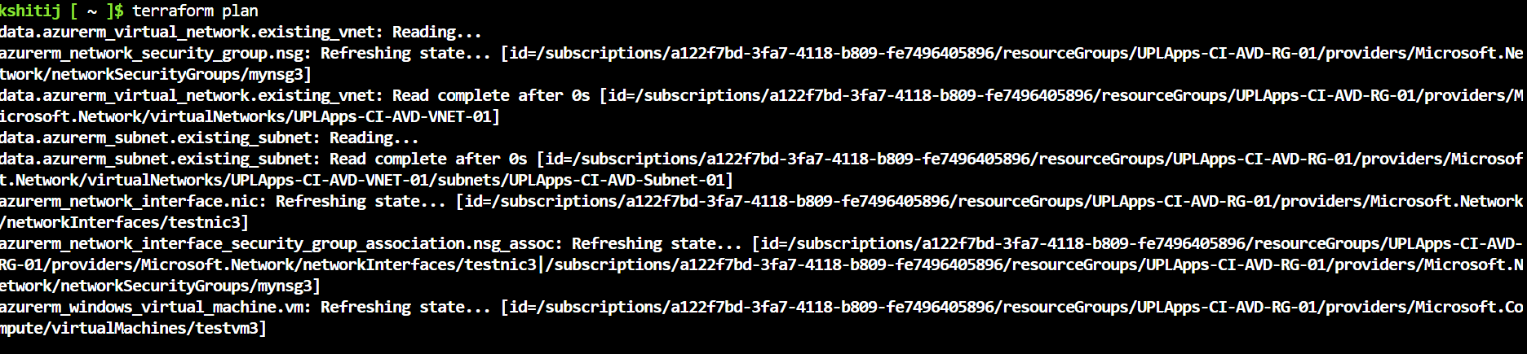
Virtual Machines(VMs)

Slide 14
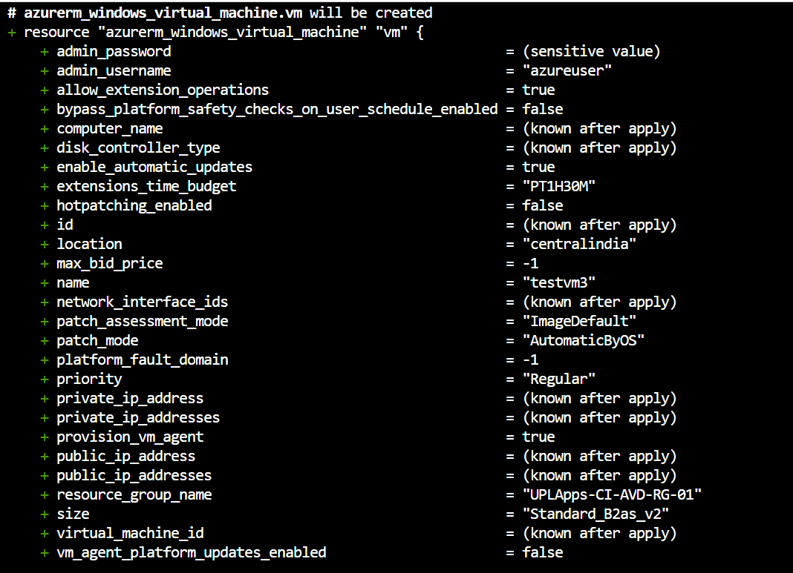
Virtual Machines(VMs)

Slide 15
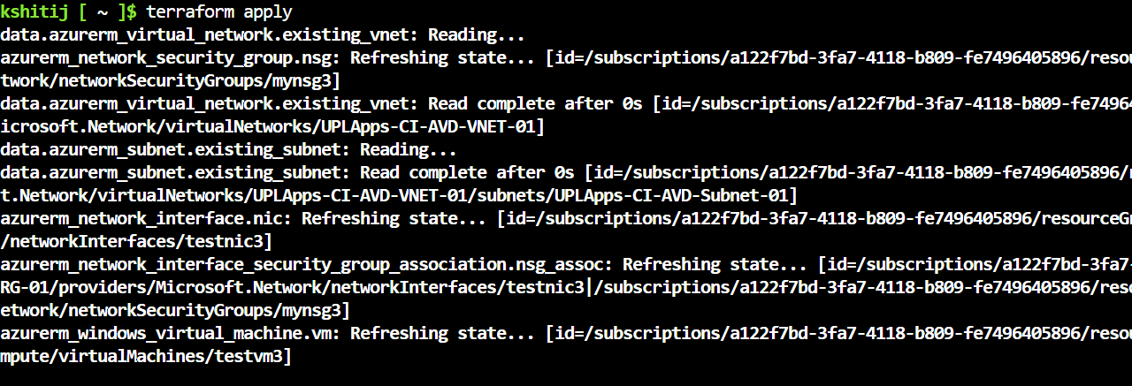
Virtual Machines(VMs)

Slide 16
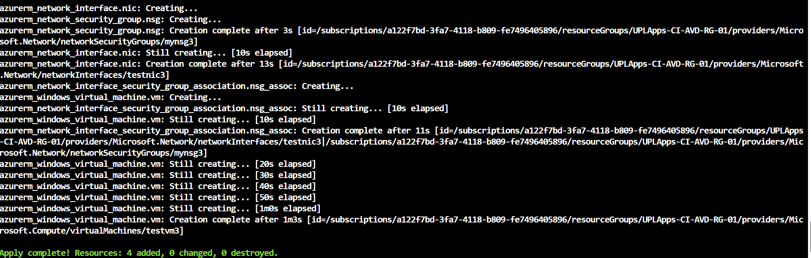
Virtual Machines(VMs)

Slide 17
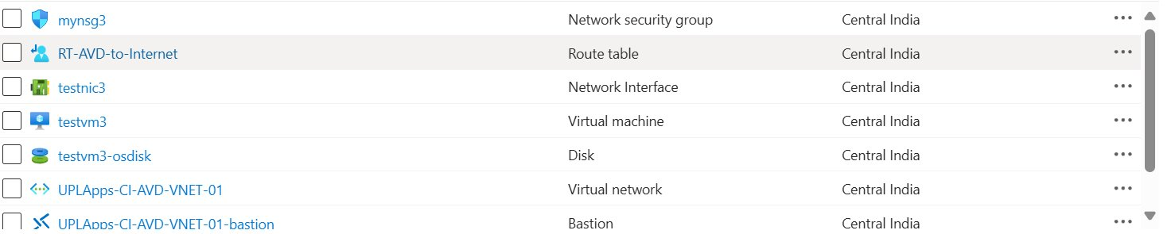
Virtual Machines(VMs)

Slide 18
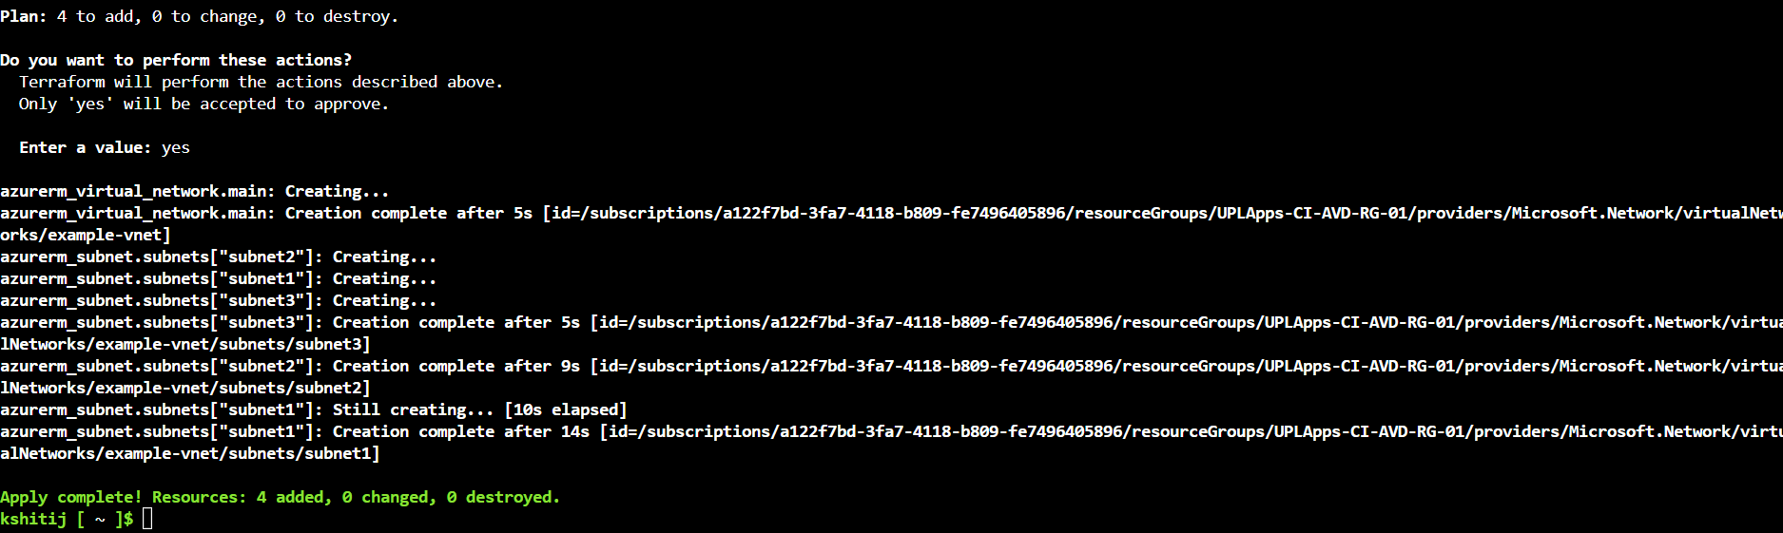
Virtual network & Subnet

Slide 19
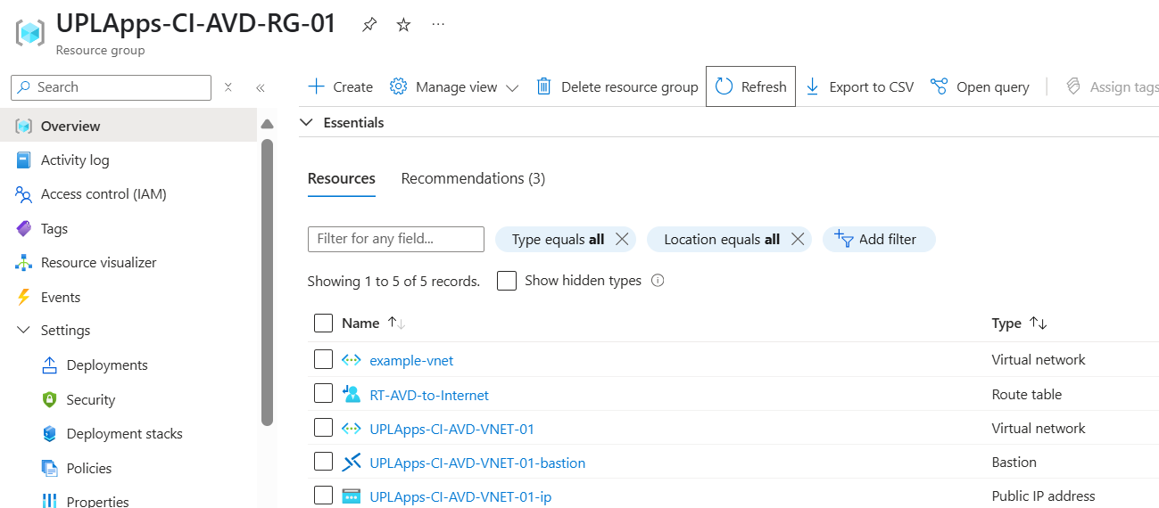
Virtual network & Subnet

Slide 20
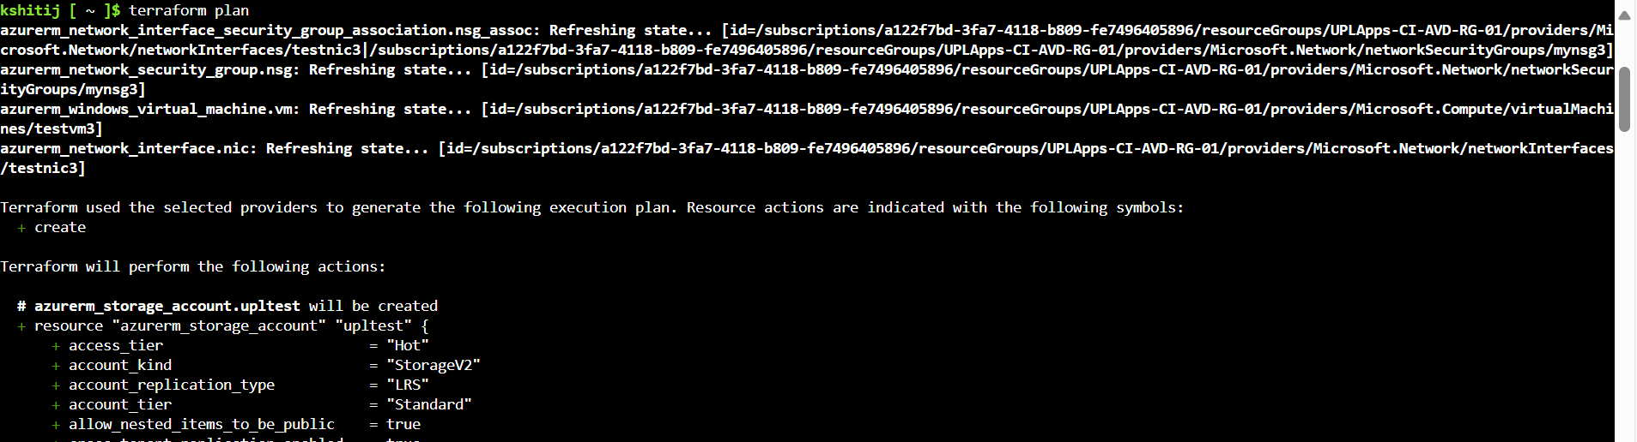
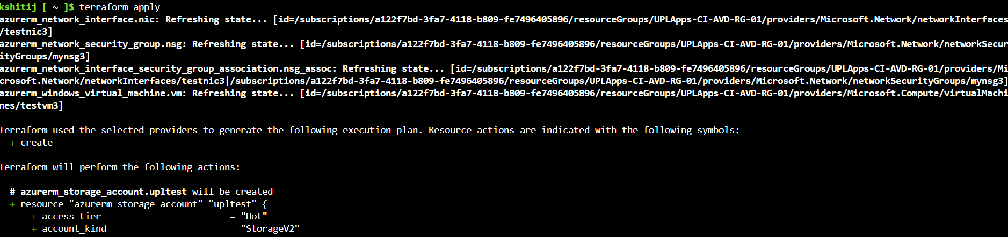
Storage Accounts

Slide 21
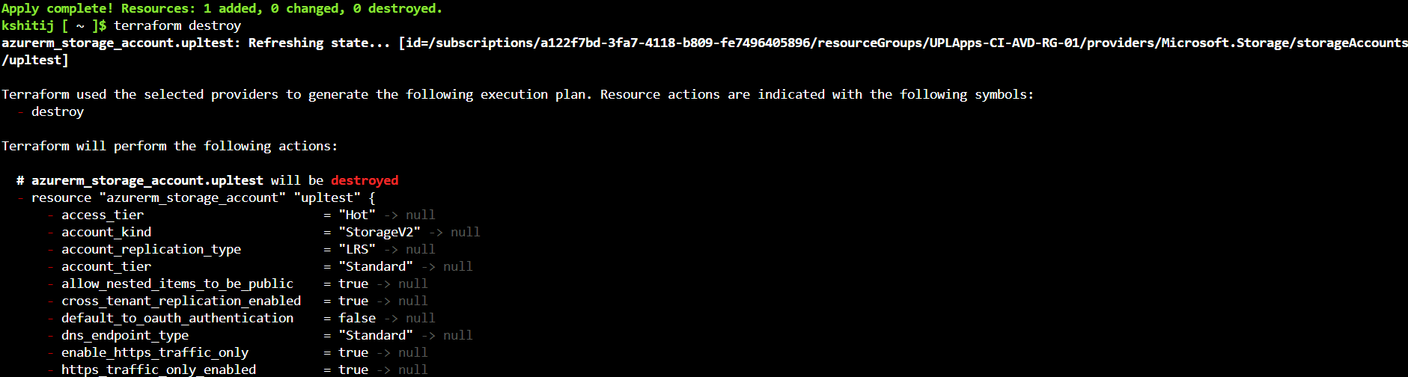
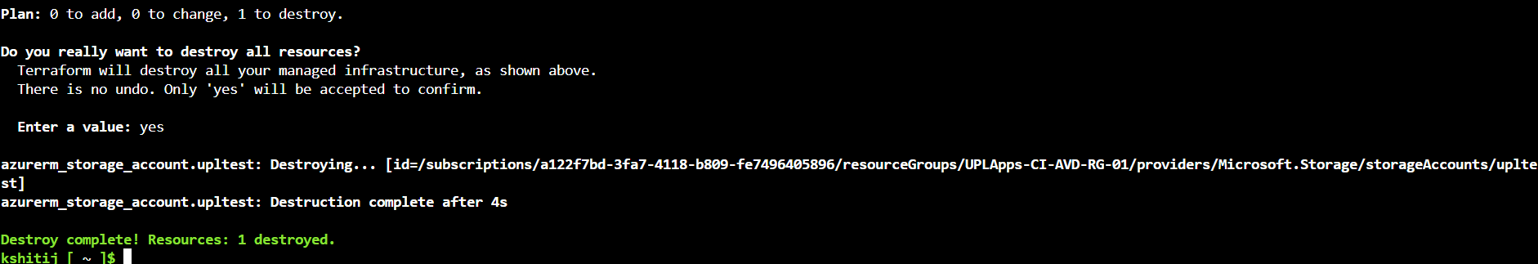
Storage Accounts

Slide 22
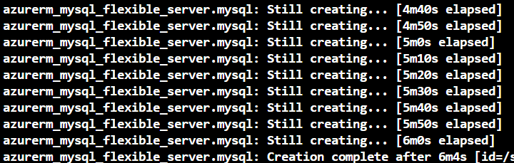
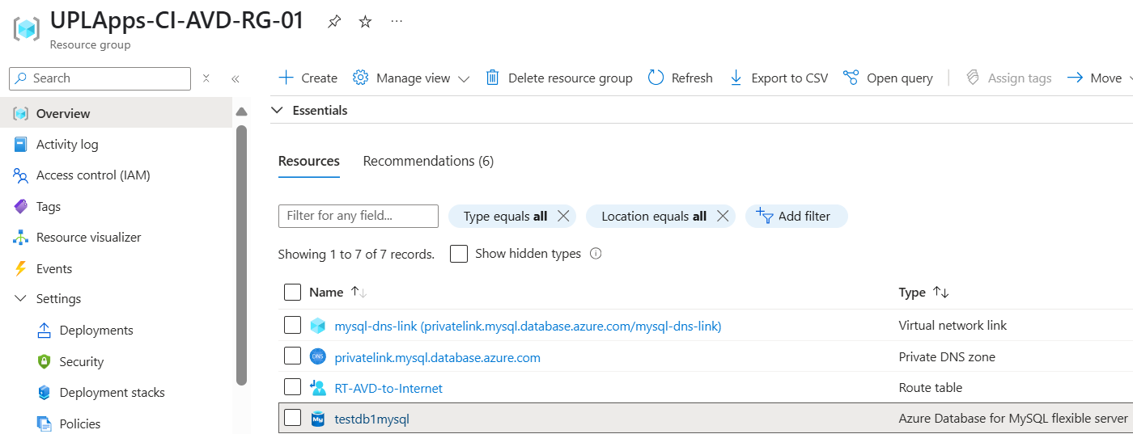
Postgre & MySQL Databases with private end-points

Slide 23
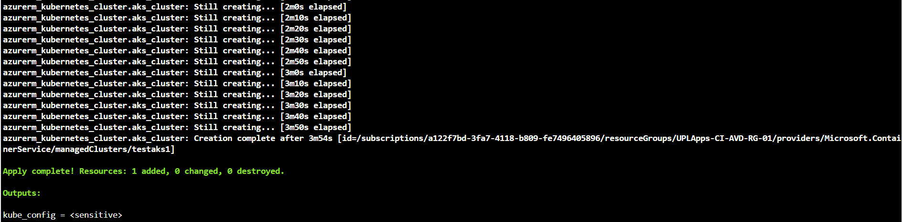
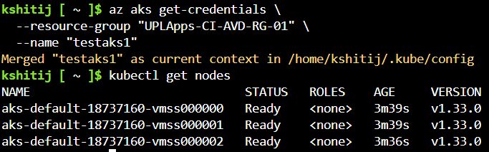
Azure Kubernetes Services(AKS)

Slide 24
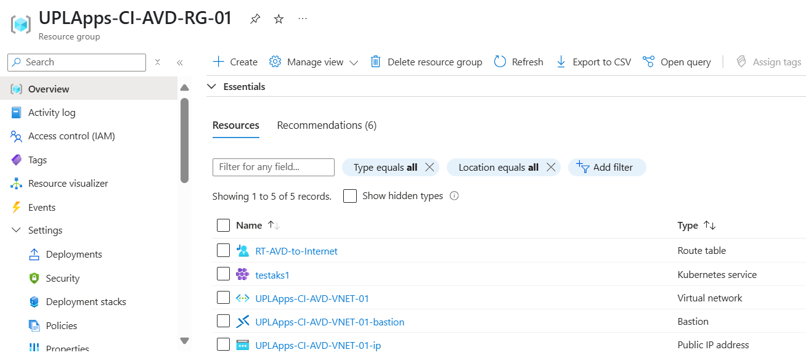
Azure Kubernetes Services(AKS)

Slide 25
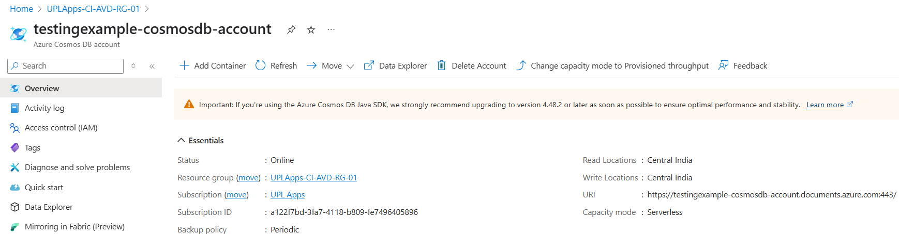
CosmoDB

Slide 26
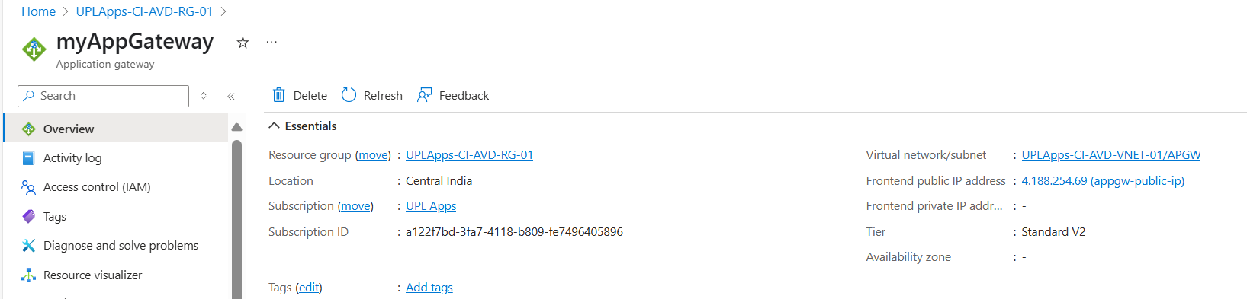
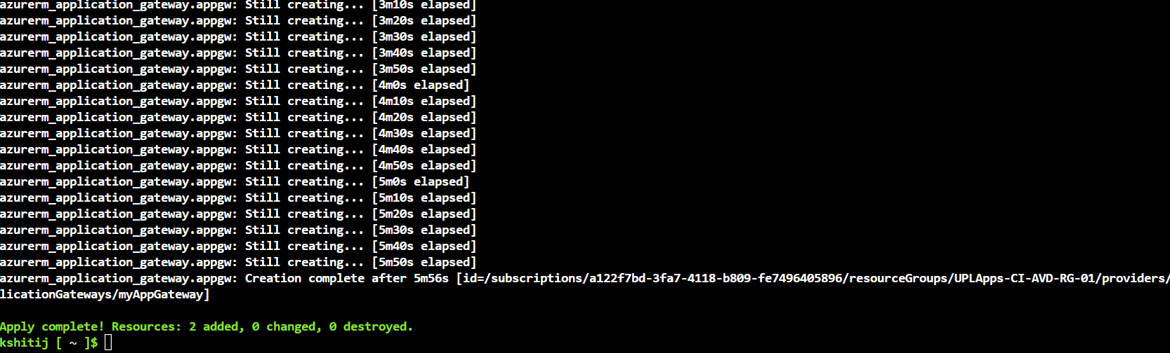
Application Gateway

Slide 27
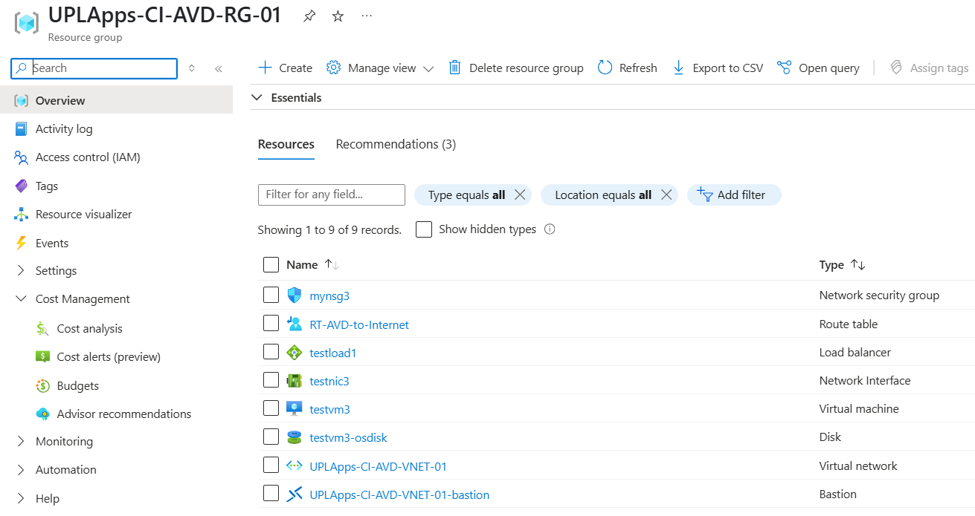
Load Balancer

Slide 28
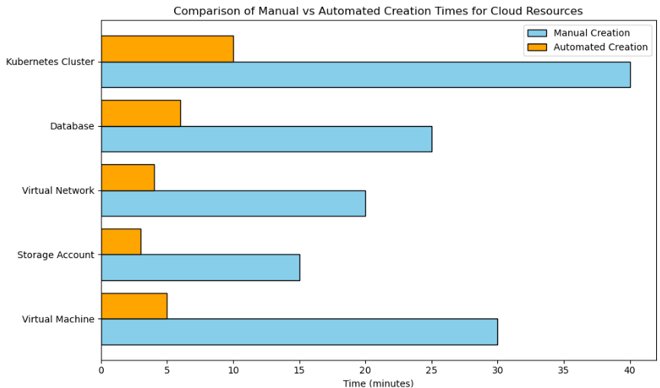
Metrics
📈

Slide 29
Ansible
What is Ansible?
Ansible is an open-source automation tool that enables efficient management of IT infrastructure. It automates tasks such as configuration management, software deployment, and system orchestration.
Key Features
Agentless Architecture – Communicates over SSH; no agents required on target machines
YAML-Based Playbooks – Easy-to-read and write automation scripts
Idempotent Execution – Ensures consistent results across multiple runs
Extensive Module Library – Supports a wide range of automation tasks

Slide 30
Ansible
How it works?
There are 2 files inventory and Playbooks executed using anisble-playbook command Step 1. Inventory(.ini files)
Defines the list of target machines (hosts) where the playbooks are going to be executed
Can be:
Static – Defined using INI or YAML files
Dynamic – Fetched from cloud providers or external sources
Step 2. Playbooks(.yml files)
Written in YAML, playbooks describe the desired system state
Contain a series of tasks to be executed on the target machines
Step 3. Executed using the command: ansible-playbook -i <inventory-name> <playbook-name>

Slide 31



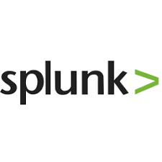
Ansible
Used Ansible to automate:
1. Google Chrome
2. CrowdStrike
3. Sapphire
4. Splunk

Slide 32
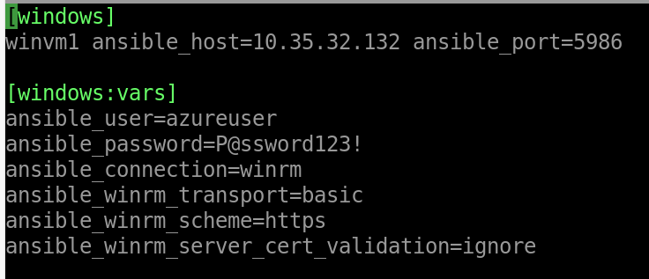
Google Chrome

Slide 33
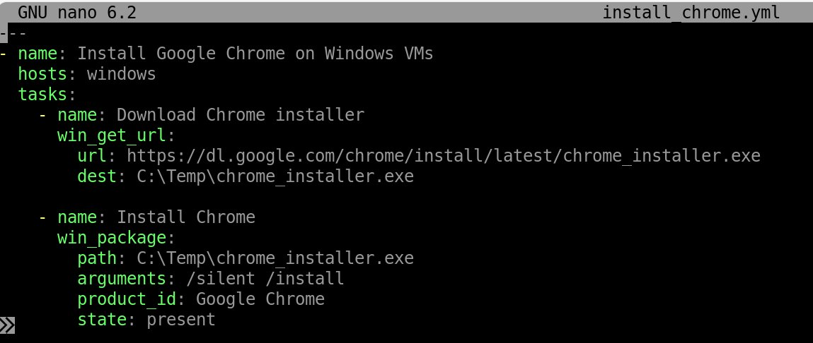
Google Chrome

Slide 34
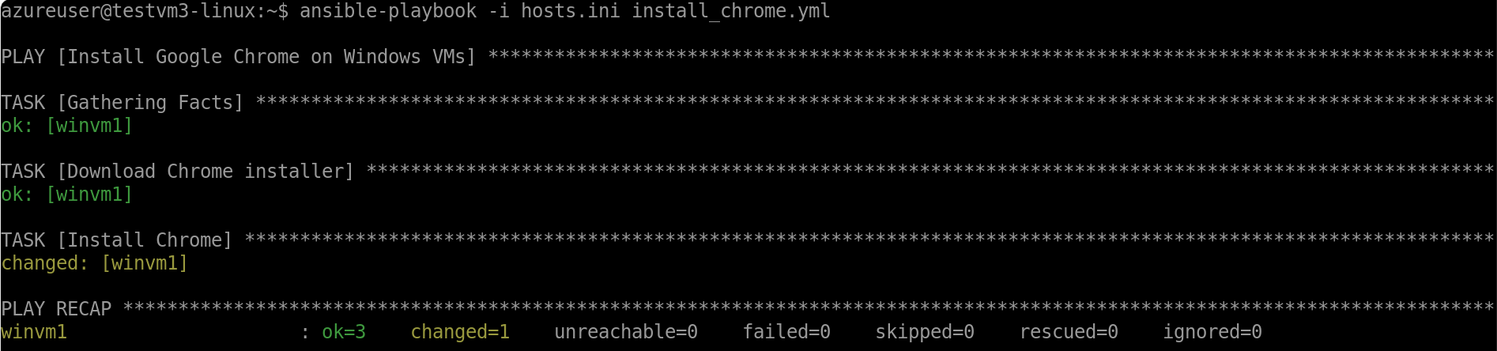
Google Chrome

Slide 35

Google Chrome

Slide 36
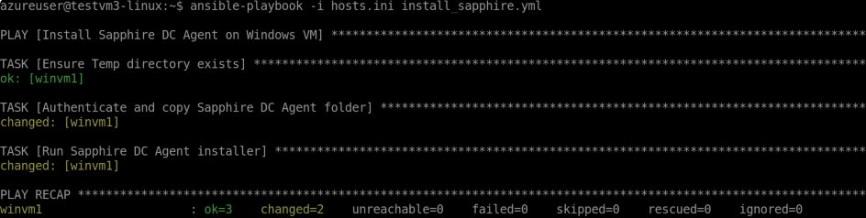
Sapphire

Slide 37
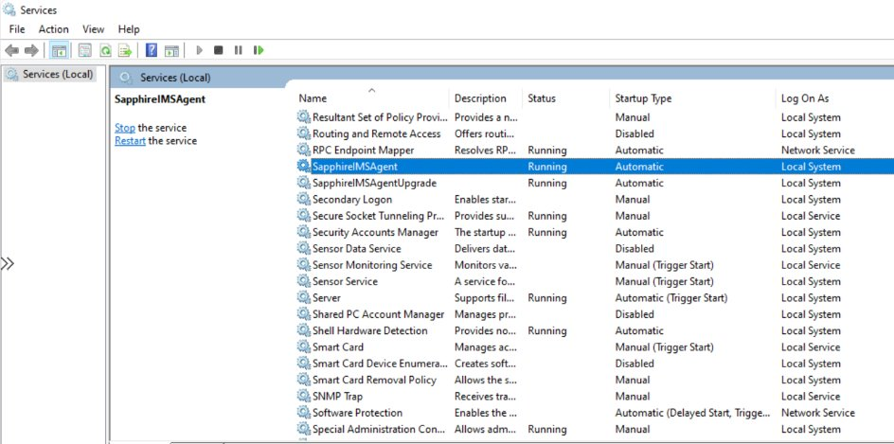
Sapphire

Slide 38
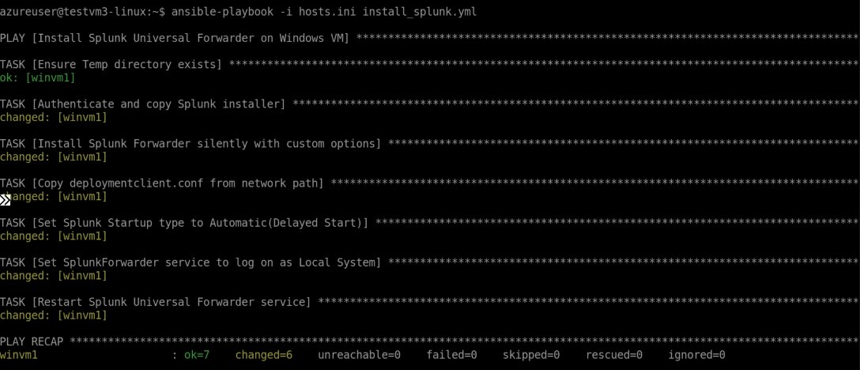
Splunk

Slide 39
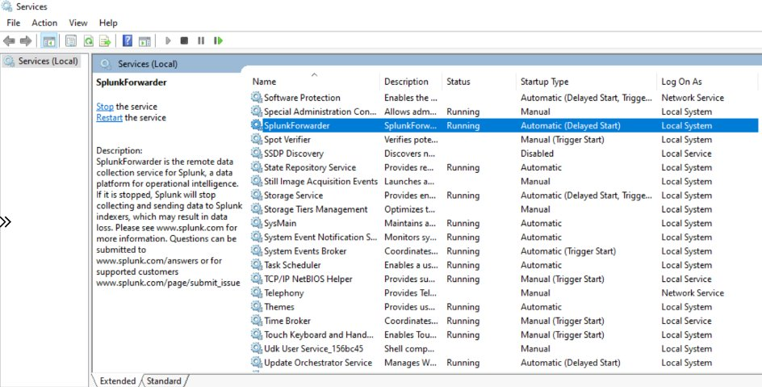
Splunk

Slide 40
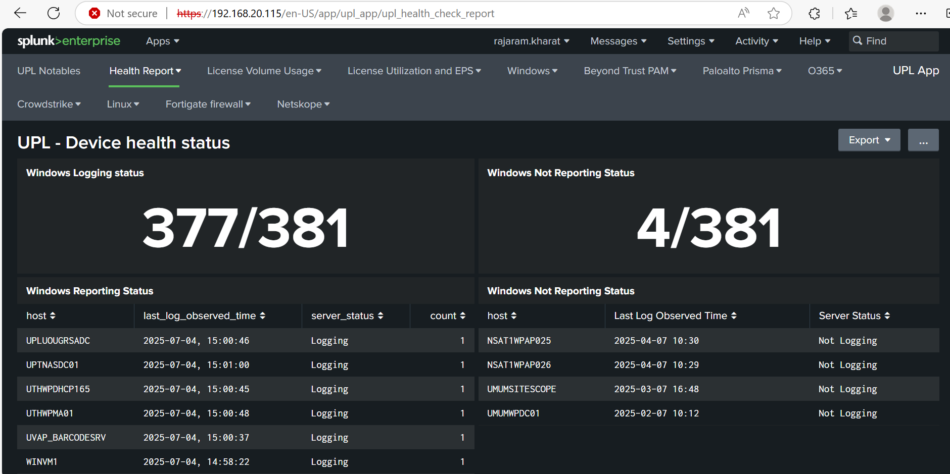
Splunk

Slide 41
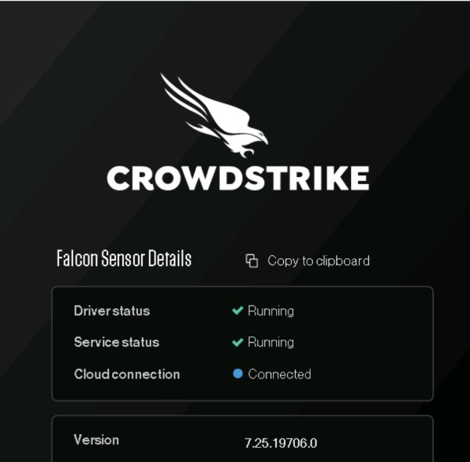
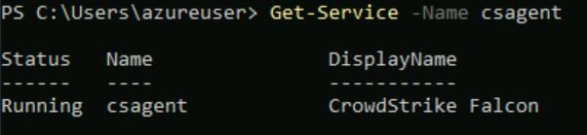
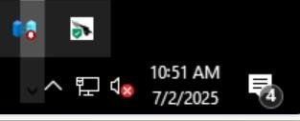
CrowdStrike

Slide 42
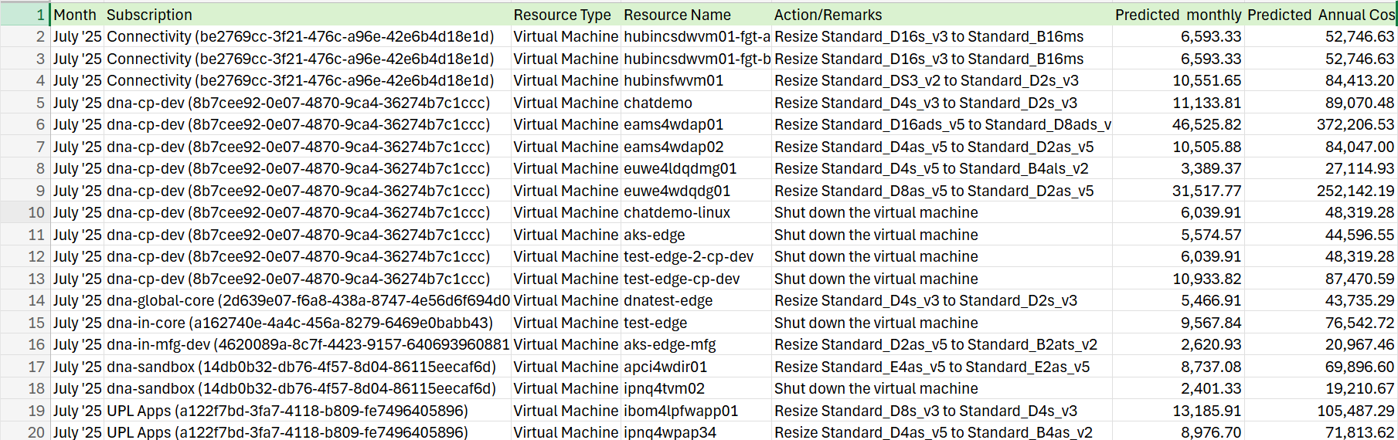
Cost Optimization- Advisor Reports

Slide 43

Cost Optimization- WorkBook Scripts

Slide 44
🚧Bottlenecks
Complexity in Understanding Cloud Networking Grasping the fundamentals of virtual networks, subnets, and routing in cloud environments was initially challenging due to my less hands-on experience with networking concepts.
Interdependencies Between Teams Working with Splunk, Crowdstrike and Sapphire required continuous support of other teams which sometimes caused delay in work as it involved third party vendors as well. This increased the time took to develop and test the scripts.
Restricted Access During VM Automation with Ansible Automating VM configurations using Ansible was complex due to restricted access policies. Installing dependencies directly on VMs required elevated privileges and network permissions, which were tightly controlled in the environment.

Slide 45

Frameworks & Recommendations
1. Use Terraform Workspaces for Environment Separation
Manage multiple environments (dev, test, prod) using isolated workspaces.
Prevent cross-environment interference with separate state files.
2. Implement Role-Based Access Control (RBAC)
Assign least-privilege roles to Terraform service principals.
Enhance security and limit access to only necessary resources.
3. Integrate Terraform with Azure Policy
Enforce compliance with organizational rules (e.g., allowed regions, VM sizes).
Validate deployments against policies to prevent misconfigurations.
4. Enable Cost Management and Tagging
Apply consistent tags (Project, Owner, Environment) to all resources.
Use Azure Cost Management to track spending and optimize usage.

Slide 46
Thank You I'm happy to take any questions

